Slide 1
Predicting Apartment Interest Level
Kyle Gallatin, David Letzler, Chris Capozzola

Slide 2
Feature Engineering
The Stuff that Worked

Slide 3
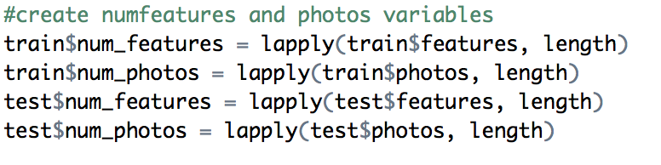
Basic Feature Engineering
In addition to price per room, date formatting, etc...things literally all of us did

Slide 4
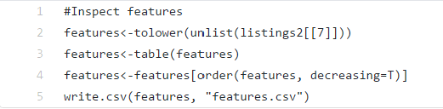
Breaking Out the Features List
 | Var1 | Freq
1 | elevator | 26273
2 | hardwood floors | 23558
3 | cats allowed | 23540
4 | dogs allowed | 22035
5 | doorman | 20967
6 | dishwasher | 20806
7 | laundry in building | 18944
8 | no fee | 18079
Each entry has a list of features
These features represent common elements of apartments
We tabulated the individual features from every listing

Slide 5
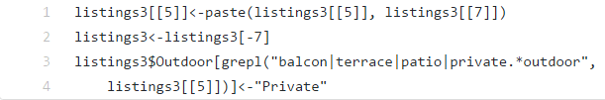
Using Regex to Generate Variables
Inspection reveals many near-synonyms
Use regex in grepl function to locate listings that possess any version of feature
Combine feature/description variables to account for listings with missing data
13 | outdoor space | 5270
14 | dining room | 5150
15 | high speed internet | 4299
16 | balcony | 3058
17 | swimming pool | 2730
18 | new construction | 2608
19 | terrace | 2313

Slide 6
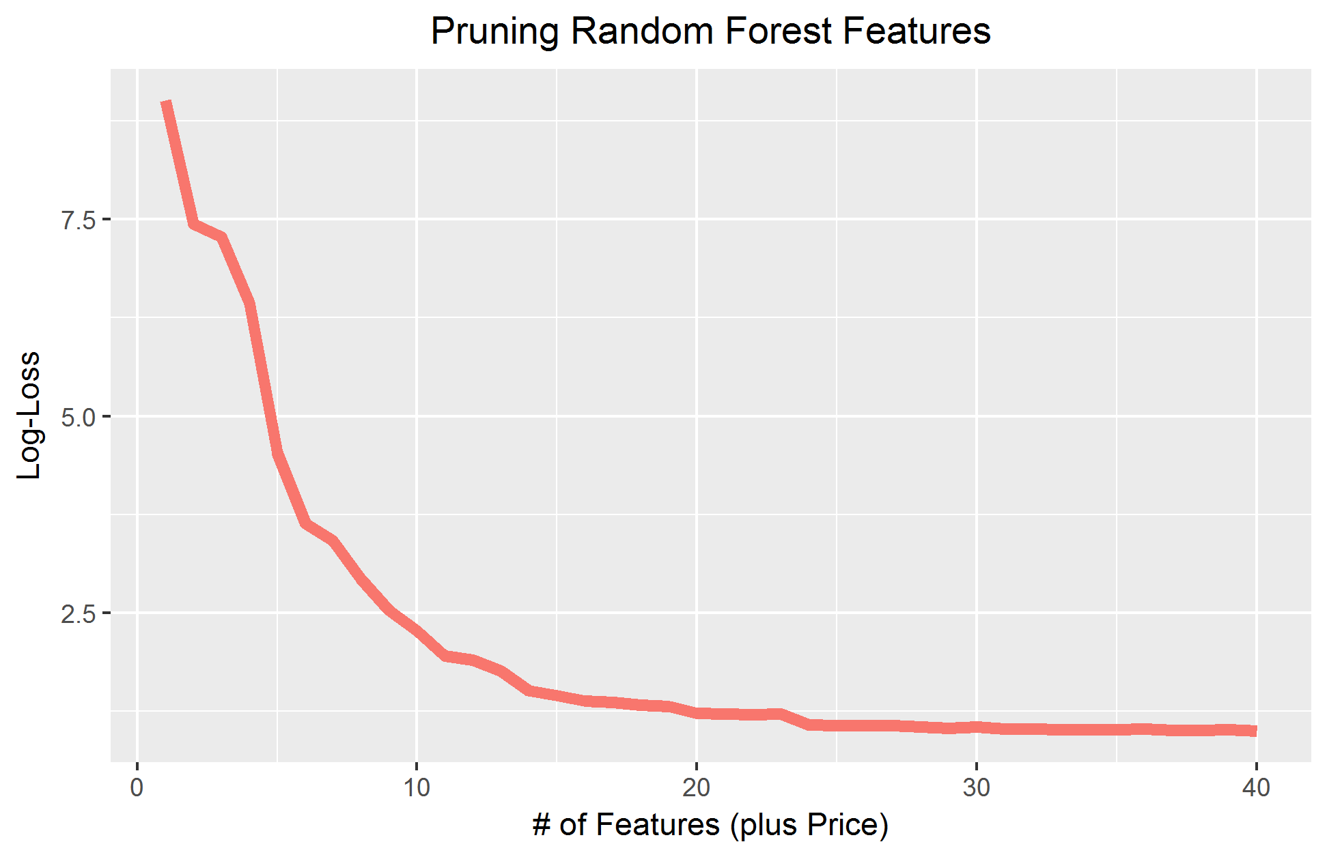
The Most Important Feature Variables
54 feature variables
Used saturated Random Forest importance table for pruning order
First ~40 variables incrementally reduced log-loss, with tapering around 25
10 Most Important Features
Prewar | Eat-in Kitchen | Dining Room
Dishwasher | No Fee | Hardwood
Newly Renovated | Elevator | Marble Bath
Cats Allowed

Slide 7
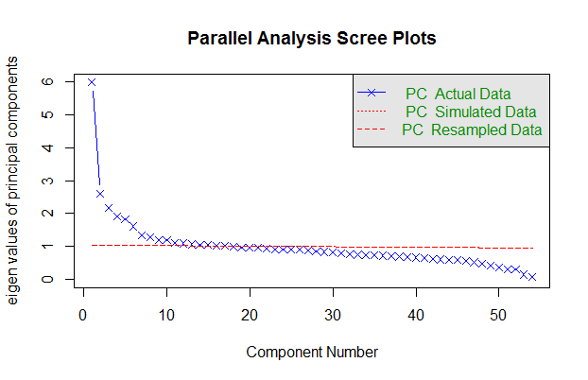
Using PCA to Optimize Feature Efficiency
Scree-plot reveals that the extracted features are mostly, but not entirely, independent.
Using PCA would slightly improve the efficiency of the feature data.
We generated a 30-component dataset to use in the final model.

Slide 8
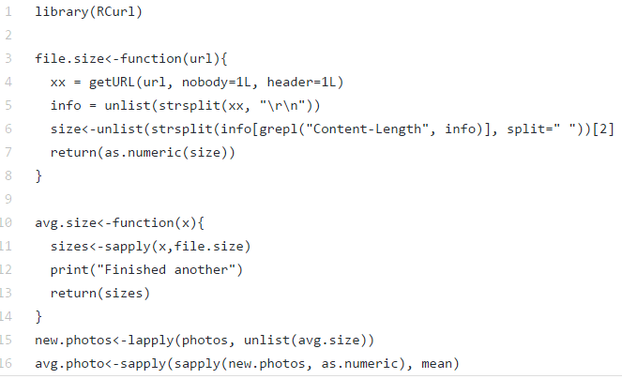
Evaluating Quality of Picture Files
How to determine the quality of the photos without having to download all 80G?
getURL queries for every picture

Slide 9
Feature Engineering
The Stuff that Didn’t Necessarily Help but Seemed Interesting at the Time

Slide 10
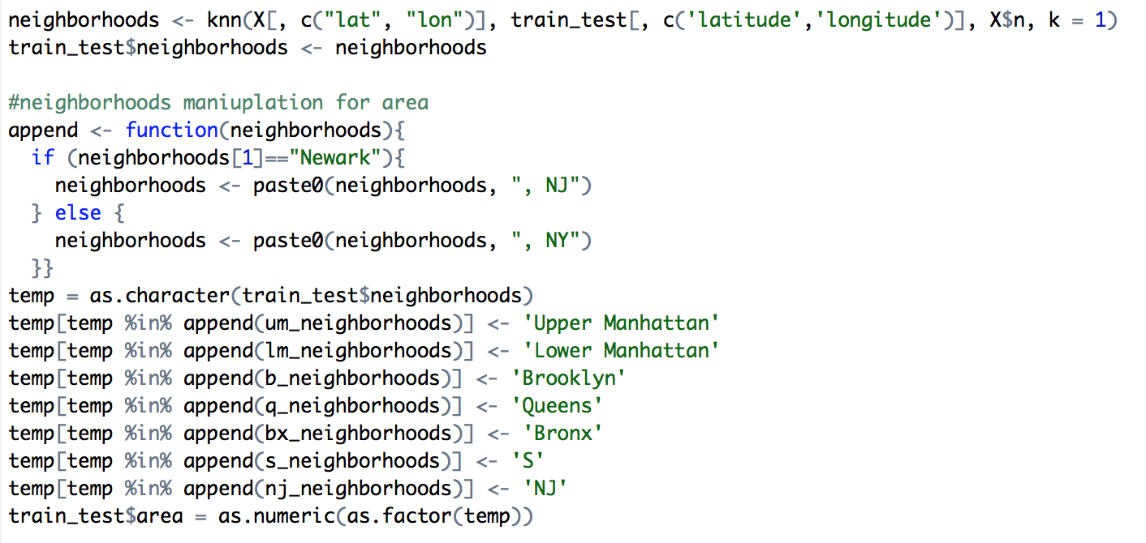
Getting Neighborhoods from Lat-Long
Used kernel code and knn to map our lat longs to neighborhoods, then back to general areas

Slide 11
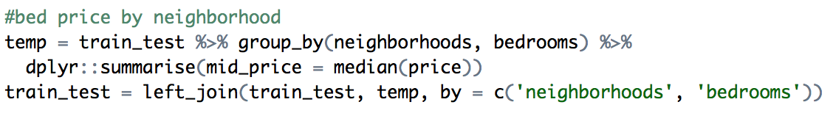
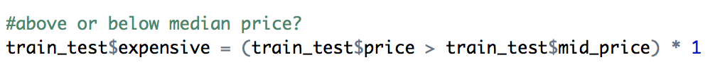
Pricing by neighborhoods
Determines relative price of apartment with respect to nearby listings

Slide 12
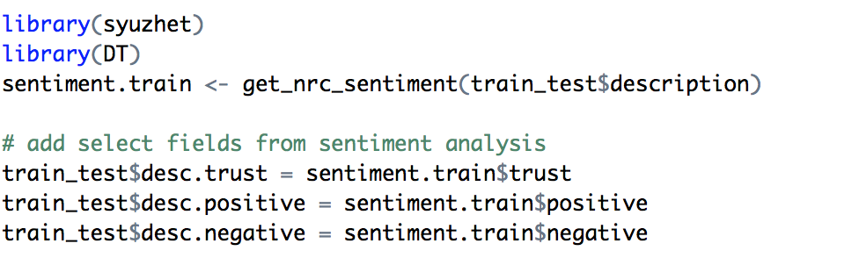
Sentiment Analysis
Listing descriptions are written with the intention of catching apartment-seekers’ attentions and give them a positive impression
Sentiment analysis can evaluate which entries have the most positive affect

Slide 13
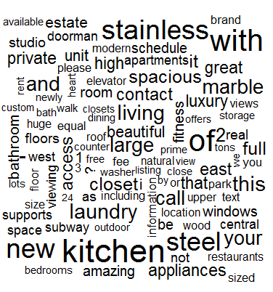
Customized Lexicon Sentiment Analysis
For that matter, real estate has a special set of sentiment words
We tabulated word frequencies and used keyness to rank them
Then we inspected high-keyness words for sentiment terms
Categories:
Positive Affect
Spaciousness
“Center-of-it-All”

Slide 14
Listing Descriptions Don’t Really Affect Interest
(So Far as We Can Tell)
No matter what method we used, descriptive sentiment did not significantly affect interest level
Most important descriptive information is already under “Features”
This does not help our model, but it does tell us something...
Apartment-seekers don’t fall for spin!

Slide 15
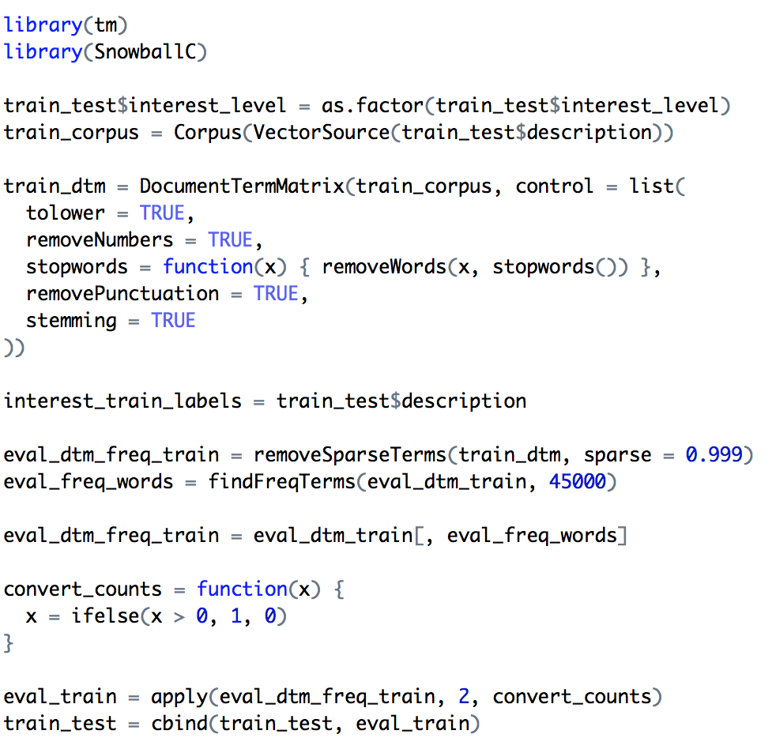
Getting a Sparse Matrix from Description
Using the tm package in R, we were able to extract words with higher frequencies from the description field
These most frequent words were then used to create new variables for each listing

Slide 16
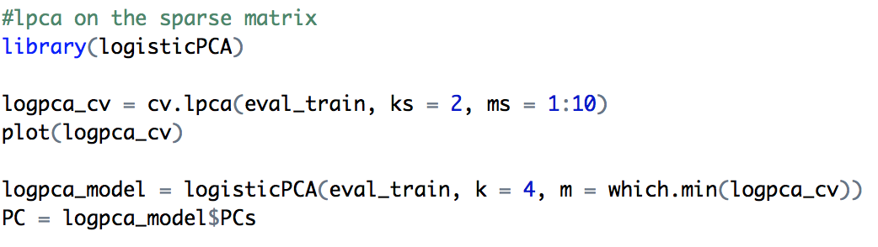
Running Logistic PCA on that Sparse Matrix
Logistic PCA is specific for binary data, so it ran well on this sparse matrix even if the PCs didn’t really seem to improve our model.
(assumed k = 2 as a test instead of running a cv as well)

Slide 17
Building the Final Model
Sklearn & xgBoost

Slide 18
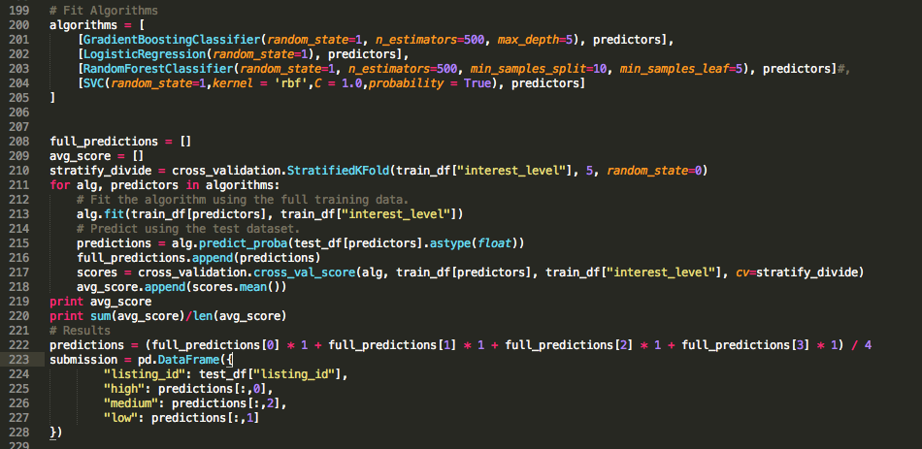
Python Test Models
After performing feature engineering, PCA, and other analyses. We implemented several basic models in python using stratified cross-validation to score each of the models.

Slide 19
Test Model Results
After using the Grid Search package in sklearn to tune the parameters of each of the 4 models, we found that the Gradient Boosting model performed the best on the test data with a log loss score of about 0.59.
Ultimately, we decided to build our final model in R, after obtaining better results with a different algorithm.

Slide 20
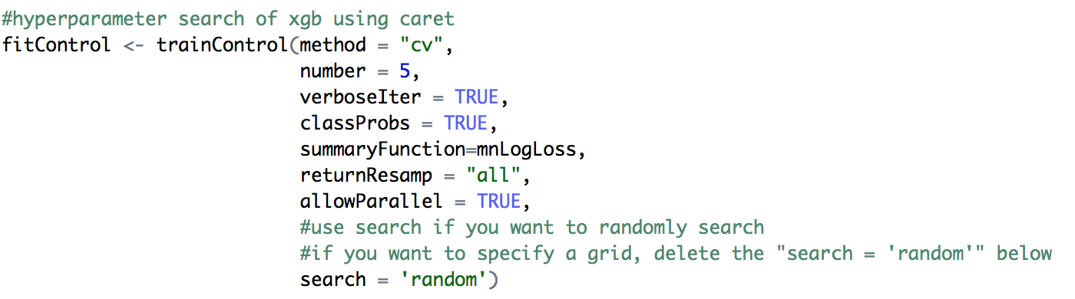
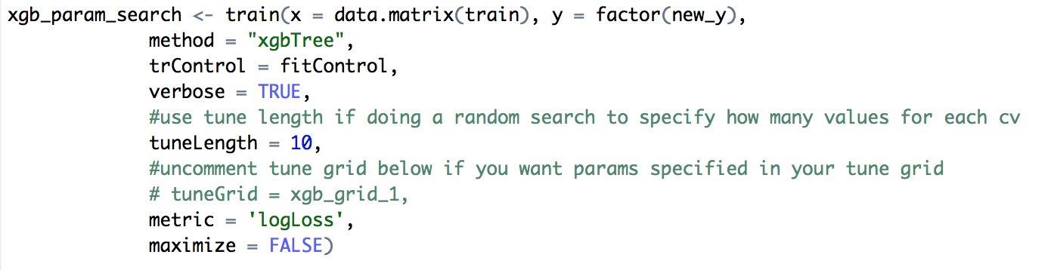
Search for xgboost Parameters with Caret
*can also be run with a prespecified tune grid

Slide 21
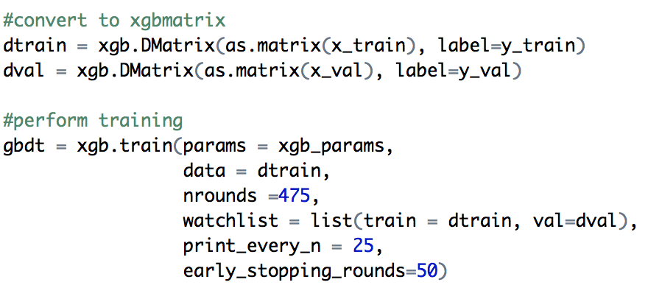
Fitting the Model with a CV fold

Slide 22
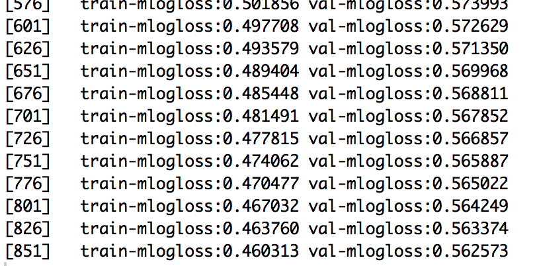
Fitting the Model with a CV fold
Final Kaggle Score: 0.56245

Slide 23
Final Features Included
PCA on features/Logistic PCA on description sparse matrix
num features/num photos/num words
Bathrooms/bedrooms/building id
manager id/created (split into separate parts)
Price/room price
street and display address/sentiment analysis
sparse matrix for description words/neighborhood
Area/avg price per neighborhood by room

